Slide 1


Mehrasa Modanlou Jouybari
10.04.2023

Slide 2

Outline
Executive Summary
Introduction
Methodology
Results
Conclusion
Appendix

Slide 3
Executive Summary
Summary of methodologies
Data collection, data wrangling, exploratory data analysis with data visualization, exploratory data analysis with SQL, building an interactive map with Folium, building a dashboard with plotly dash, predictive analysis
Summary of all results
Exploratory data analysis results
Interactive analytics demo
Predictive analysis results

Slide 4
Introduction
Project background and context
SpaceX is a aerospace manufacturer, space transportation services and communications corporation which is a disruptive just like Tesla both founded by Elon Musk. Despite being less than 20 years old SpaceX has managed to reduce the cost by more than 50% compared to other company and said to reduce by 99% when the Starship project will be completed.
This is because spaceX has developed Technology to land the first stage booster which is 70% the cost of the rocket. By landing it safely they are able to reuse the booster and the cost of the launches. Using their reused boosters cost 50% less of their their cost to use a new booster and this has made spaceX the company of that dominate the market. SpaceX has gained worldwide attention for a series of historic milestones.
It is the only private company ever to return a spacecraft from low-earth orbit, which it first accomplished in December 2010. SpaceX advertises Falcon 9 rocket launches on its website with a cost of 62 million dollars wheras other providers cost upward of 165 million dollars each, much of the savings is because Space X can reuse the first stage.
Therefore if we can determine if the first stage will land, we can determine the cost of a launch. This information can be used if an alternate company wants to bid against SpaceX for a rocket launch.
Problems you want to find answers
How does the success of the first stage landing depend on factors such cargo mass, launch site, number of flights, and orbits?
Does the frequency of successful landings rise with time?
What is the most effective method that can be applied in this situation for binary classification?

Slide 5

Section 1

Slide 6
Methodology
Executive Summary
Data collection methodology:
Through SpaceX’s API
Through scraping Wikipedia
Perform data wrangling
Filtering, handling missing values, using one hot encoding to prepare the data to a binary classification
Perform exploratory data analysis (EDA) using visualization and SQL
Perform interactive visual analytics using Folium and Plotly Dash
Perform predictive analysis using classification models
How to build, tune, evaluate classification models

Slide 7
Data Collection
Data was gathered using a combination of API queries to SpaceX's REST API and web scraping of information from a table in the Wikipedia entry for the company. In order to obtain comprehensive data about the launches for a more in-depth analysis, we had to use both of these data collection techniques.

Slide 8
Data Collection – SpaceX API
Present your data collection with SpaceX REST calls using key phrases and flowcharts
https://github.com/MehrasaModanlou/Applied-Data-Science-Capstone/blob/main/jupyter-labs-spacex-data-collection-api.ipynb -
Decoding the response content and turning fit into dataframe
Requesting rocket launch data from SpaceX API
Requesting needed information about the launches from SpaceX API by applying custom functions
Constructing data we have obtained into a dictionary
Creating a dataframe from the dictionary
Filtering the dataframe to only include Falcon 9 launches
Exporting the data to CSV
Replacing missing values of Payload Mass by setting them to the mean for this column

Slide 9
Requesting Falcon 9 launch data from Wikipedia
Data Collection - Scraping
Creating a BeautifulSoup object from the HTML response
Present your web scraping process using key phrases and flowcharts
https://github.com/MehrasaModanlou/Applied-Data-Science-Capstone/blob/main/jupyter-labs-webscraping.ipynb -
Extracting all column names from the HTML table header
Collecting the data by parsing HTML tables
Constructing data we have obtained into a dictionary
Creating a dataframe from the dictionary
Exporting the data to CSV

Slide 10
Perform exploratory Data Analysis and determine Training Lables
Data Wrangling
Calculate the number of launches on each site
After collecting the data we check the missing data and data types, and do one of the following to clean the data:
Deal with Null values: Replace the missing data with one-Using mean, median or so.
Change data type of the data.
Represent categorical data using integer or float dummy numbers – one hot encoding
split data into train and test set
https://github.com/MehrasaModanlou/Applied-Data-Science-Capstone/blob/main/labs-jupyter-spacex-data_wrangling_jupyterlite.jupyterlite.ipynb -
Claculate the number and occurrence of each orbit
Claculate the number and occurrence of mission outcome per orbit type
Creating a landing outcome label from Outcome column
Exporting the data to CSV

Slide 11
EDA with Data Visualization
Summarize what charts were plotted and why you used those charts
Flight Number vs. Payload Mass, Flight Number vs. Launch Site, Payload Mass vs. Launch Site, Orbit Type vs. Success Rate, Flight Number vs. Orbit Type, Payload Mass vs Orbit Type and Success Rate Yearly Trend
The relationship between variables is displayed through scatter plots. If a connection can be made, a machine learning model could use it. Bar graphs display comparisons between distinct categories. The objective is to demonstrate the connection between a measured value and the particular categories that are being compared. Line diagrams display data trends over time. (time series).
https://github.com/MehrasaModanlou/Applied-Data-Science-Capstone/blob/main/jupyter-labs-eda-dataviz.ipynb.jupyterlite.ipynb -

Slide 12
EDA with SQL
Using bullet point format, summarize the SQL queries you performed
Displaying the names of the unique launch sites in the space mission
Displaying 5 records where launch sites begin with the string ‘CCA‘
Displaying the total payload mass carried by boosters launched by NASA (CRS)
Displaying average payload mass carried by booster version F9 v1.1
Listing the date when the first successful landing outcome in ground pad was achieved
Listing the names of the boosters which have success in drone ship and have payload mass greater than 4000 but less than 6000
Listing the total number of successful and failure mission outcomes
Listing the names of the booster versions which have carried the maximum payload mass
Listing the failed landing outcomes in drone ship, their booster versions and launch site names for the months in year 2015
Ranking the count of landing outcomes (such as Failure (drone ship) or Success (ground pad)) between the date 2010-06-04 and 2017-03-20 in descending order
https://github.com/MehrasaModanlou/Applied-Data-Science-Capstone/blob/main/jupyter-labs-eda-sql-coursera_sqllite.ipynb -

Slide 13
Build an Interactive Map with Folium
Markers of all Launch Sites: - Added Marker with Circle, Popup Label and Text Label of NASA Johnson Space Center using its latitude and longitude coordinates as a start location.
- Added Markers with Circle, Popup Label and Text Label of all Launch Sites using their latitude and longitude coordinates to show their geographical locations and proximity to Equator and coasts.
Coloured Markers of the launch outcomes for each Launch Site:
- Added coloured Markers of success (Green) and failed (Red) launches using Marker Cluster to identify which launch sites have relatively high success rates.
Distances between a Launch Site to its proximities:
- Added coloured Lines to show distances between the Launch Site KSC LC-39A (as an example) and its proximities like Railway, Highway, Coastline and Closest City.
https://github.com/MehrasaModanlou/Applied-Data-Science-Capstone/blob/main/lab_jupyter_launch_site_location.jupyterlite.ipynb -

Slide 14
Build a Dashboard with Plotly Dash
Added a dropdown list to enable Launch Site selection
Added a pie chart to show the total successful launches count for all sites and the success vs failed counts for the site if a specific launch site was selected
Added a slider to select payload range
Added a scatter chart to show the correlation between payload and launch success
https://github.com/MehrasaModanlou/Applied-Data-Science-Capstone/blob/main/spacex_dash_app.py -

Slide 15
Predictive Analysis (Classification)
1. Creating a NymPy array from the column Class in data 2. Standardizing the data with StandardScaler then fitting and transforming it 3. Splitting the data into training and testing sets with train_test_split function 4. Creating a GridSearchCV object with cv=10 to find the best parameters 5. Applying GridSearchCV on LogReg, SVM, Decision Tree, and KNN models 6. Calculating the accuracy on the test data using the method .score() for all models 7. Examining the confusion matrix for all models 8. Finding which method performs best by examining the Jaccard_score and F1_score metrics
https://github.com/MehrasaModanlou/Applied-Data-Science-Capstone/blob/main/SpaceX_Machine_Learning_Prediction_Part_5.jupyterlite.ipynb -

Slide 16
Results
Exploratory data analysis results
Interactive analytics demo in screenshots
Predictive analysis results

Slide 17

Section 2

Slide 18
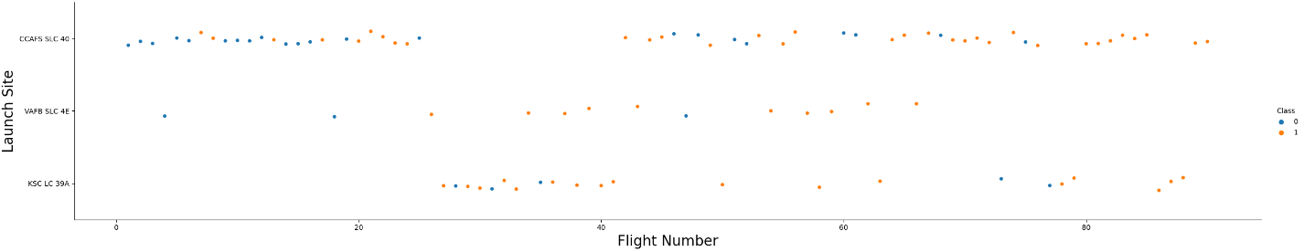
Flight Number vs. Launch Site
The earliest flights all failed while the latest flights all succeeded.
The CCAFS SLC 40 launch site has about a half of all launches.
VAFB SLC 4E and KSC LC 39A have higher success rates.
It can be assumed that each new launch has a higher rate of success

Slide 19
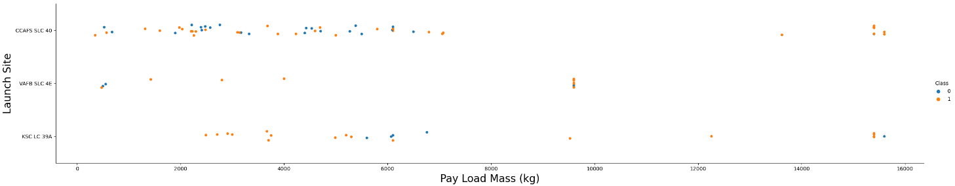
Payload vs. Launch Site
For every launch site the higher the payload mass, the higher the success rate
Most of the launches with payload mass over 7000 kg were successful
KSC LC 39A has a 100% success rate for payload mass under 5500kg too

Slide 20
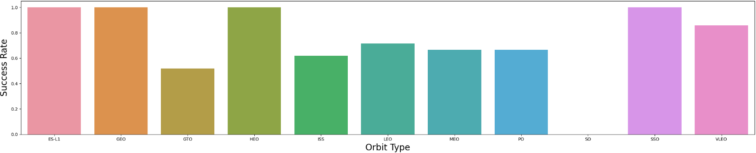
Success Rate vs. Orbit Type
Orbits with 100% success rate: ES-L1, GEO, HEO, SSO
Orbits with 0% success rate: SO
Orbits with success rate between 50% and 85%: GTO, ISS, LEO, MEO, PO

Slide 21
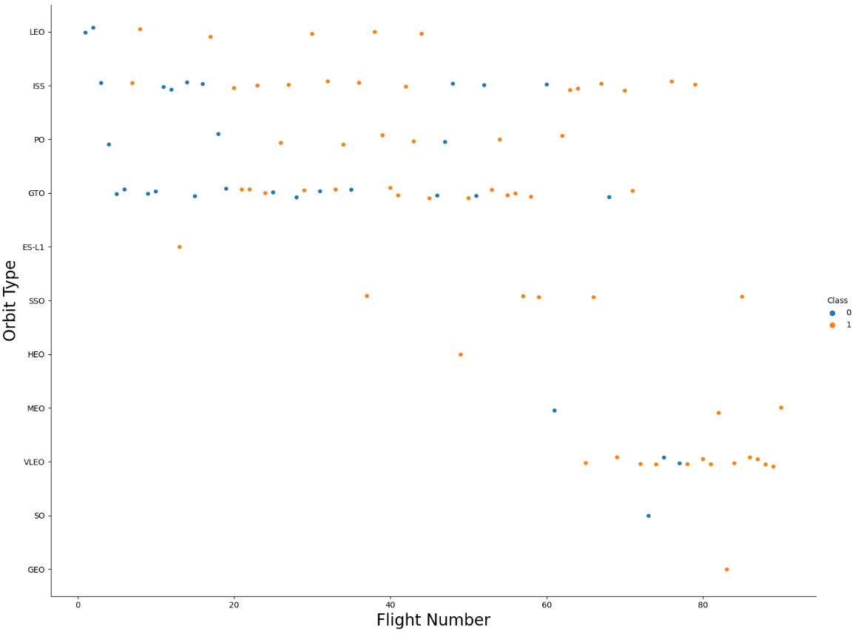
Flight Number vs. Orbit Type
In the LEO orbit the success appears related to the number of flights; on the other hand, there seems to be no relationship between flight number when in GTO orbit

Slide 22
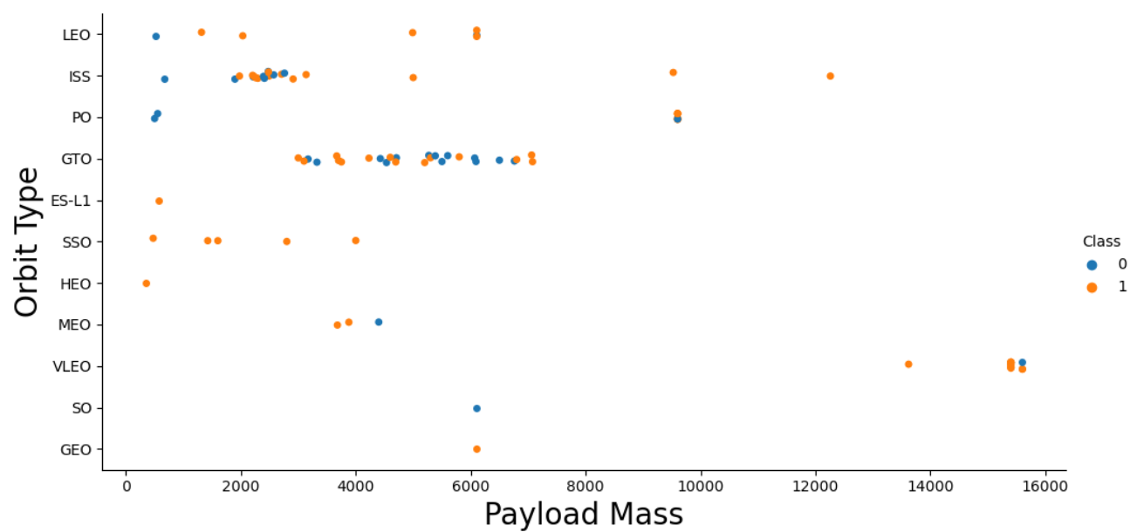
Payload vs. Orbit Type
Heavy payloads have a negative influence on GTO orbits and positive influence o Polar LEO (ISS) orbits

Slide 23
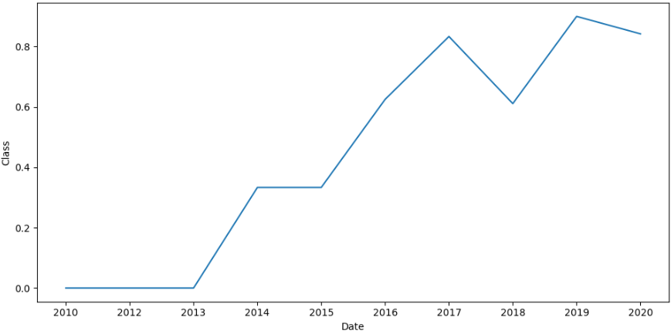
Launch Success Yearly Trend
the sucess rate since 2013 kept increasing till 2020

Slide 24
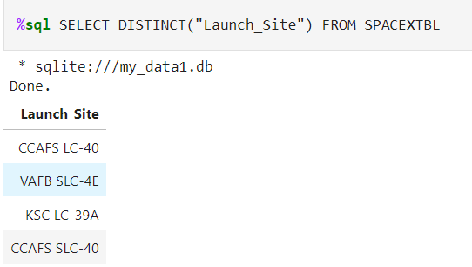
All Launch Site Names
Displaying the names of the unique launch sites in the space mission

Slide 25
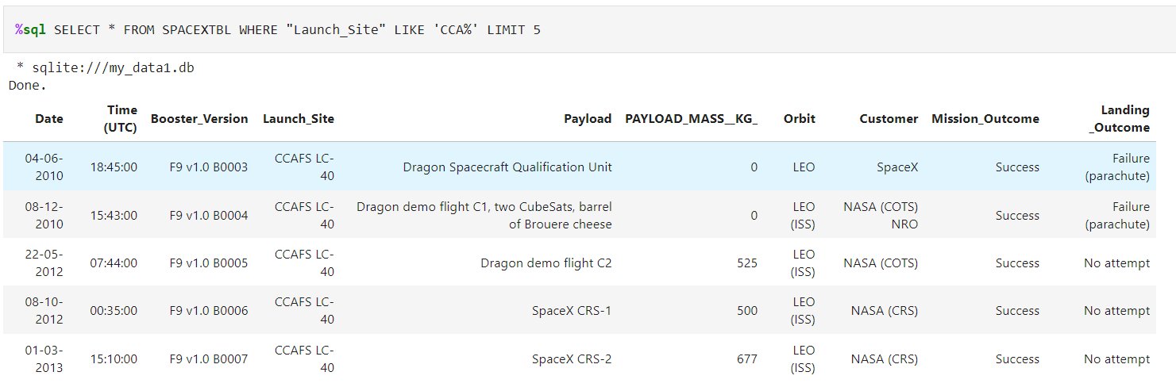
Launch Site Names Begin with 'CCA'
Displaying 5 records where launch sites begin with the string 'CCA'.

Slide 26
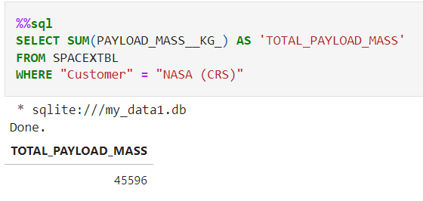
Total Payload Mass
Displaying the total payload mass carried by boosters launched by NASA (CRS)

Slide 27
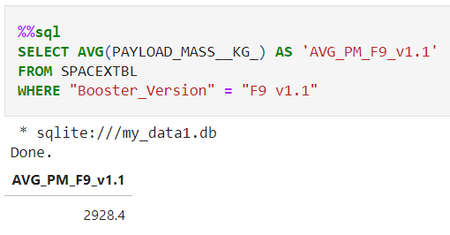
Average Payload Mass by F9 v1.1
Displaying average payload mass carried by booster version F9 v1.1

Slide 28
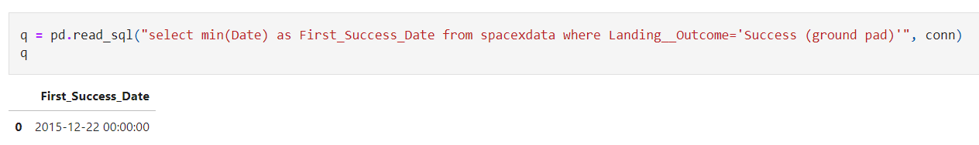
First Successful Ground Landing Date
Listing the date when the first succesful landing outcome in ground pad was acheived.

Slide 29
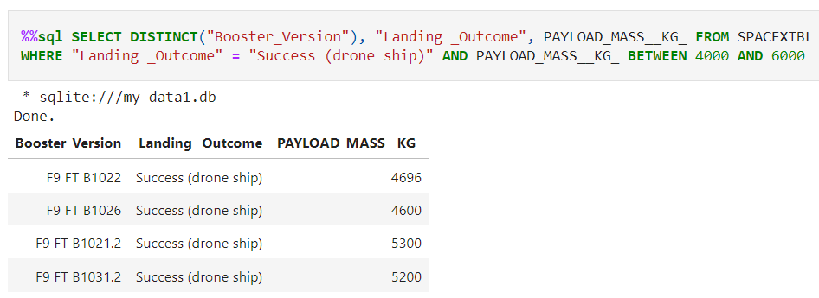
Successful Drone Ship Landing with Payload between 4000 and 6000
Listing the names of boosters which have successfully landed on drone ship and had payload mass greater than 4000 but less than 6000

Slide 30
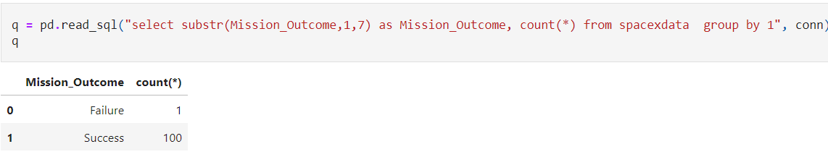
Total Number of Successful and Failure Mission Outcomes
Listing the total number of successful and failure mission outcomes

Slide 31
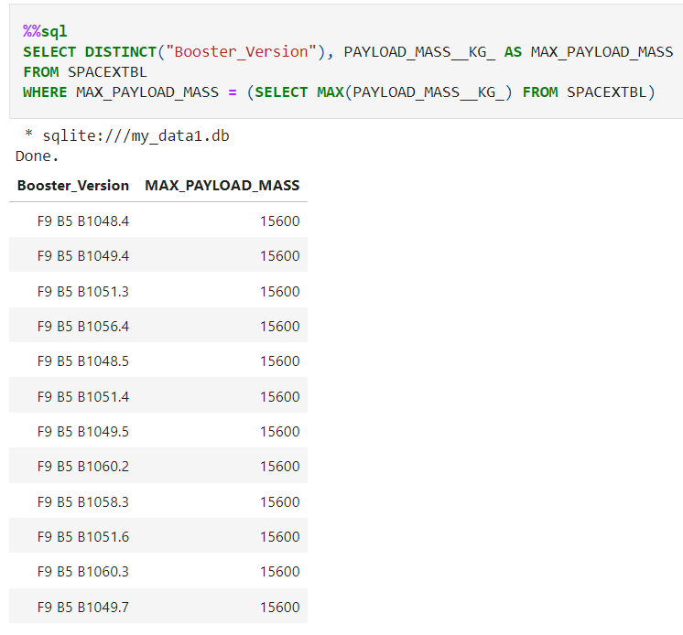
Boosters Carried Maximum Payload
Listing the names of the booster versions which have carried the maximum payload mass

Slide 32
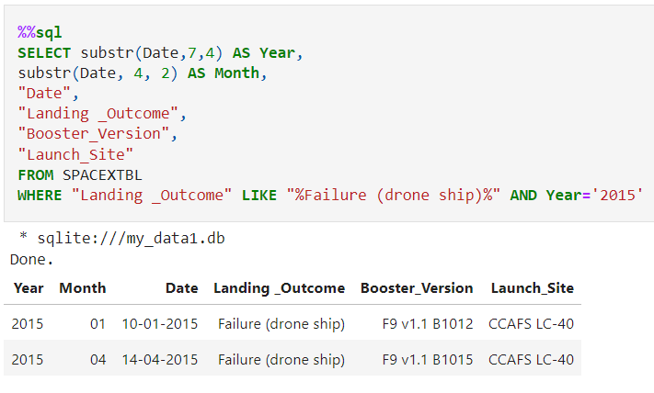
2015 Launch Records
Listing the failed landing_outcomes in drone ship, their booster versions, and launch site names for in year 2015

Slide 33
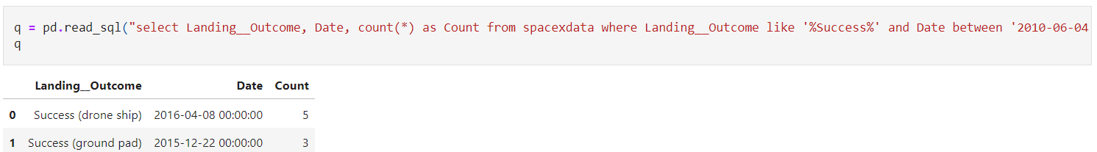
Rank Landing Outcomes Between 2010-06-04 and 2017-03-20
Ranking the count of landing outcomes (such as Failure (drone ship) or Success (ground pad)) between the date 2010-06-04 and 2017-03-20, in descending order

Slide 34

Section 3

Slide 35
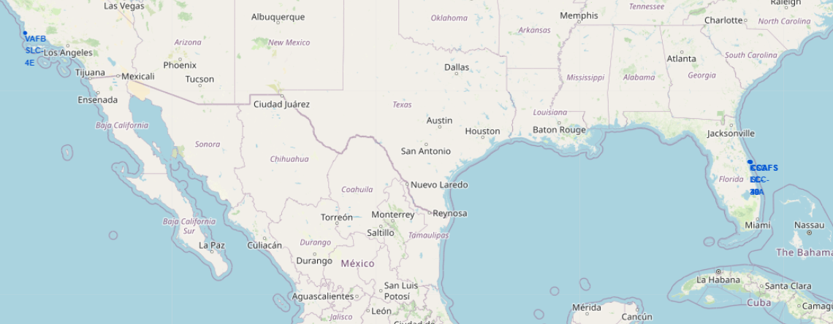
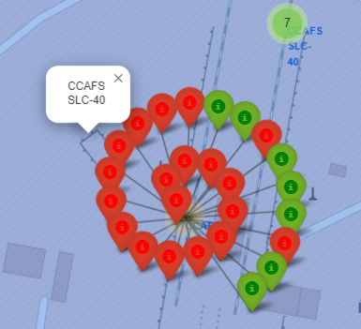
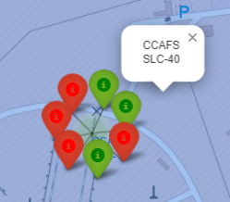
All launch sites’ location markers on a global map
Most of Launch sites are in proximity to the Equator line. The land is moving faster at the equator than any other place on the surface of the Earth. Anything on the surface of the Earth at the equator is already moving at 1670 km/hour. If a ship is launched from the equator it goes up into space, and it is also moving around the Earth at the same speed it was moving before launching. This is because of inertia. This speed will help the spacecraft keep up a good enough speed to stay in orbit.
All launch sites are in very close proximity to the coast, while launching rockets towards the ocean it minimises the risk of having any debris dropping or exploding near people.

Slide 36
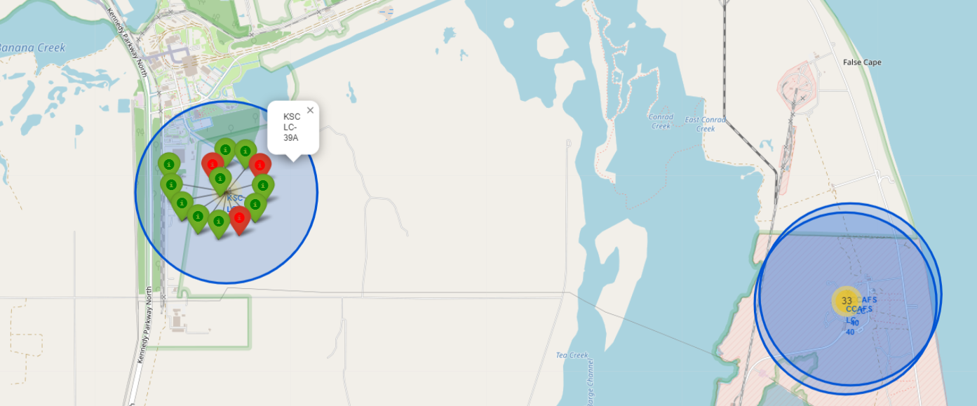
Colour-labeled launch records on the map
From the colour-labeled markers we should be able to easily identify which launch sites have relatively high success rates. Green Marker = Successful Launch, Red Marker = Failed Launch
Launch Site KSC LC-39A has a very high Success Rate.

Slide 37
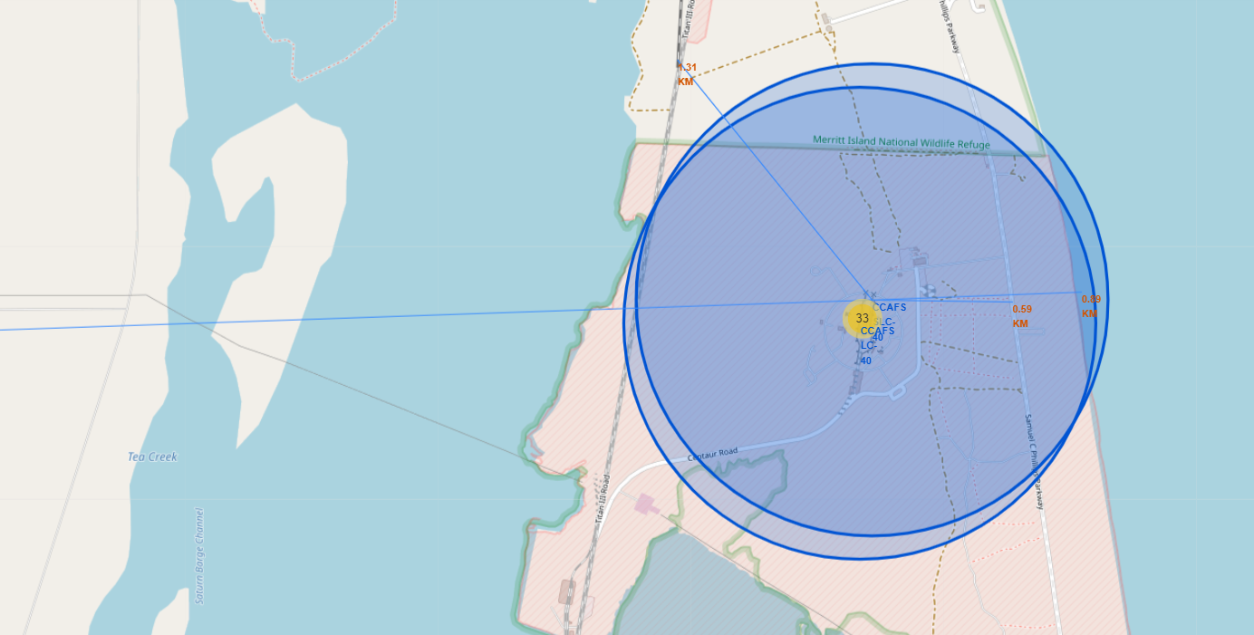
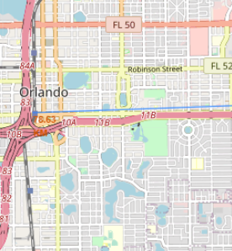
Distance from the launch site CCAFS SLC-40 to its proximities
From the visual analysis of the launch site CCAFS SLC-40 we can clearly see that it is: relative close to railway (1.31 KM), relative close to highway (0.59 KM), relative close to coastline (0.89 KM).
Also the launch site CCAFS SLC-40 is relative far from its closest city Orlando (78.63 KM).

Slide 38

Section 4

Slide 39
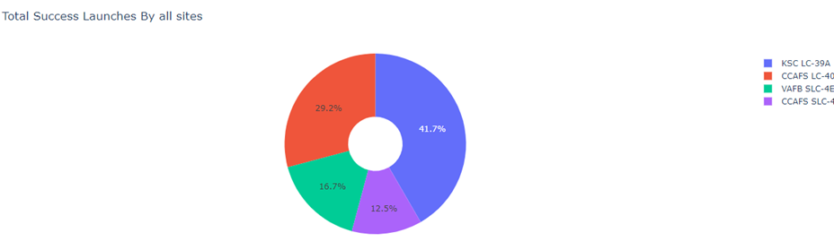
Launch success count for all sites
The chart clearly shows that from all the sites, KSC LC-39A has the most successful launches.

Slide 40
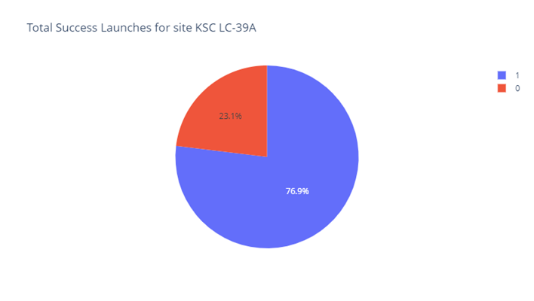
Launch site with highest launch success ratio
KSC LC-39A has the highest launch success rate (76.9%) with 10 successful and only 3 failed landings.

Slide 41
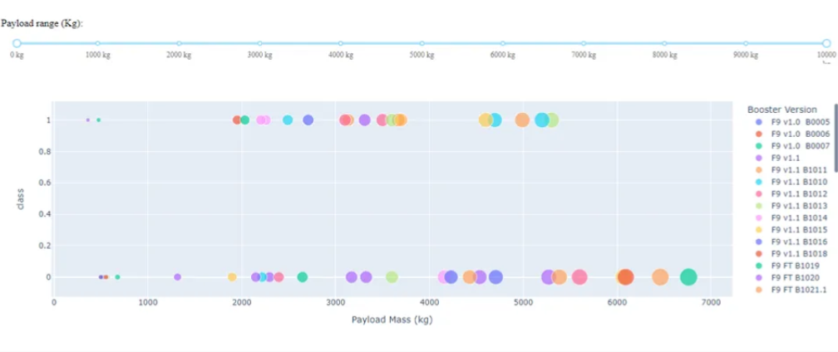
Payload Mass vs. Launch Outcome for all sites
The charts show that payloads between 2000 and 5500 kg have the highest success rate.
Among F9 Booster version (v1.0, v1.1, FT, B4, B5, etc.), FT has the highest launch success rate with 15 successes and 8 failures.

Slide 42

Section 5

Slide 43
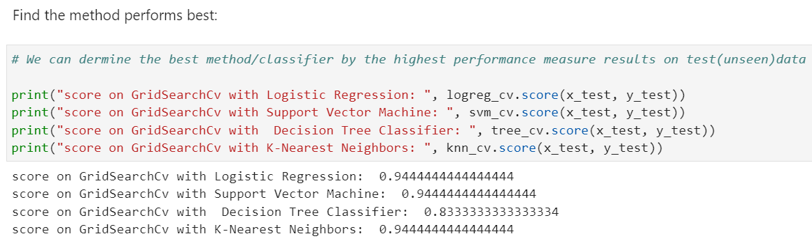
Classification Accuracy
KNN, Logistic Regression and SVM obtained superior results against Decision Tree.
The best accuracy score was about 0.94%

Slide 44
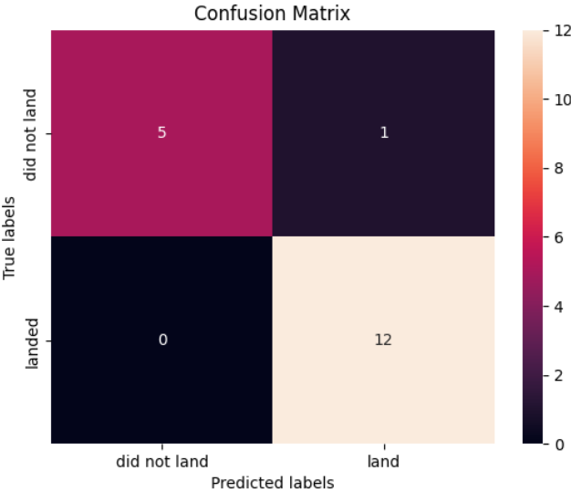
Confusion Matrix
Examining the confusion matrix, we see that Logistic Regression, Support Vector Machine, K-Nearest Neighbors can distinguish between the different classes. We see that the major problem is false positive.

Slide 45
Conclusions
Logistic Regression, Support Vector Machine, K-Nearest Neighbors Models are the best algorithm for this dataset.
Launches with a low payload mass show better results than launches with a larger payload mass.
Most of launch sites are in proximity to the Equator line and all the sites are in very close proximity to the coast.
The success rate of launches increases over the years.
KSC LC-39A has the highest success rate of the launches from all the sites.
Orbits ES-L1, GEO, HEO and SSO have 100% success rate.

Slide 46
Appendix
Include any relevant assets like Python code snippets, SQL queries, charts, Notebook outputs, or data sets that you may have created during this project

Slide 47


